Slide 1

An Introduction
TDD
Test Driven Development
Ali Karami
Technical Consultant
Sparta Global

Slide 2

What is TDD ?
Write a test before code
Use test to drive the design
XP: Test-First Programming
XP: Emergent Design

Slide 3

Why TDD ?
Simple design and minimal code
Higher quality code due to less defects
Lower maintenance cost
Brings fun back to programming

Slide 4
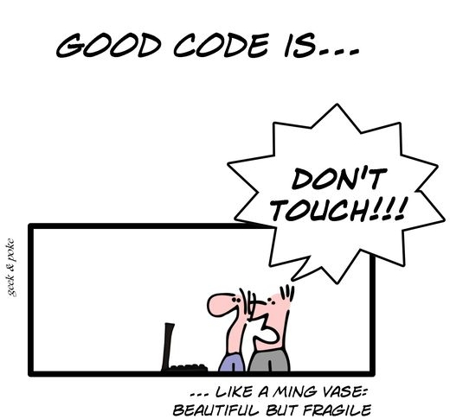

Slide 5
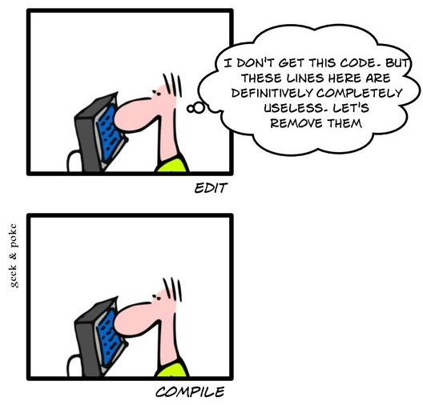
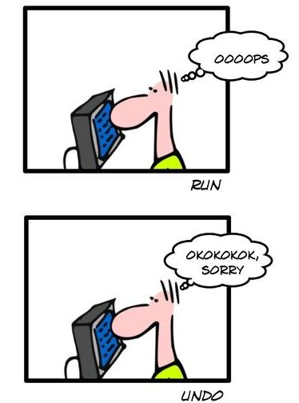
Test is a Validation tool …
Notes:
Validate the behavior of code against :
Developer’s intent
Client’s wish

Slide 6
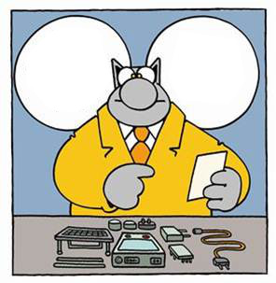
… but also a Documentation tool
It’s written:
Sort out
your own problems!
Here is a pretty clear user manual
Notes:
Tests give us :
Example of how to use the code
Code specifications (limit use, examples, …)
Client specifications (how a functionality is meant to be used)

Slide 7
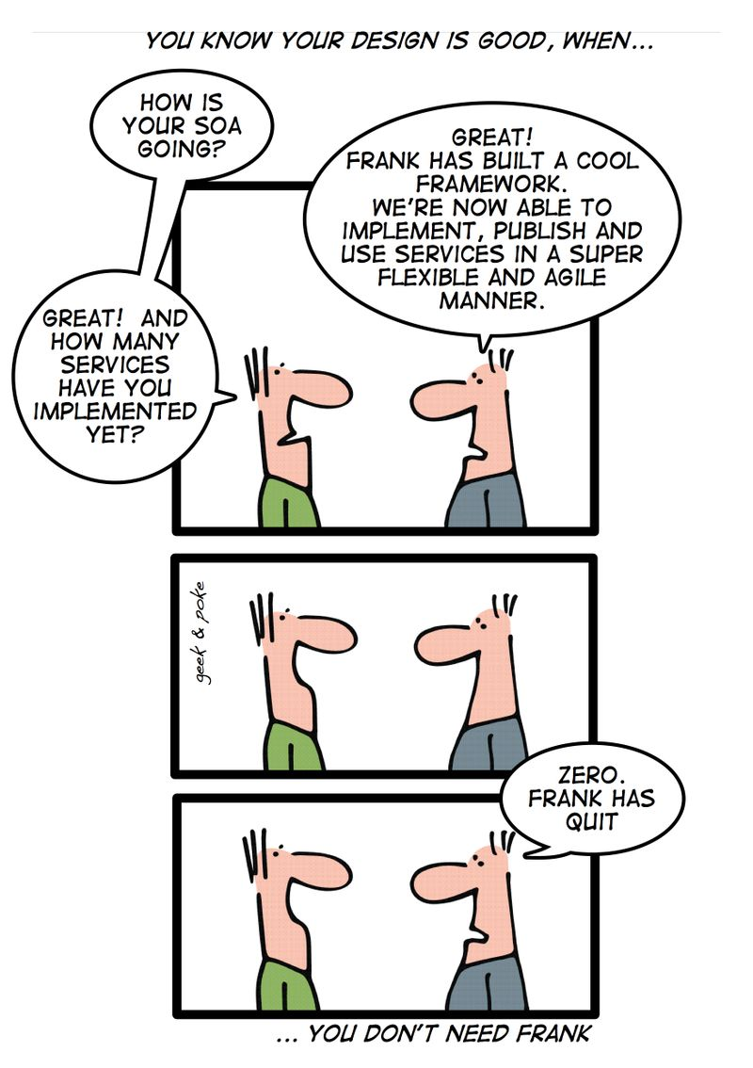
… and a Design tool
Notes:
We are the first user of our code
We write simpler code
We define simpler APIs

Slide 8


Write a test
Refactoring of tests
Refactoring
It does not compile
Refactoring of code
Test passes
Write needed API
Implement
Test compiles
but fail

Slide 9

Any Question?

